Slide 1
Android Sensors
Nisar Ahmed Siddiqui

Slide 2
Sensors
Most Android-powered devices have built-in sensors that measure motion, orientation, and various environmental conditions
These sensors are capable of providing raw data with high precision and accuracy

Slide 3
Types of sensors
Motion Sensors
Position Sensors
Environment Sensors

Slide 4
Types of sensors (contd…)
Motion sensors: These sensors measure acceleration forces and rotational forces along three axes. This category includes accelerometers, gravity sensors, gyroscopes, and rotational vector sensors.
Environmental sensors: These sensors measure various environmental parameters, such as ambient air temperature and pressure, illumination, and humidity. This category includes barometers, photometers, and thermometers.
Position sensors: These sensors measure the physical position of a device. This category includes orientation sensors and magnetometers.

Slide 5
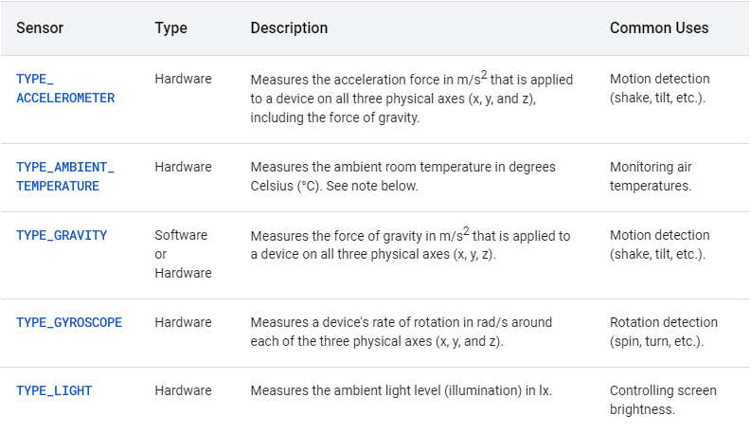
Example

Slide 6
Important Classes
SensorManager: This class provides various methods for accessing and listing sensors, registering and unregistering sensor event listeners, and acquiring orientation information
Sesnor: This class provides various methods that let you determine a sensor's capabilities.
SensorEvent: The system uses this class to create a sensor event object, which provides information about a sensor event
SensorEventListener: This interface is used to listen the changes happening in sensor.

Slide 7
Steps when working with sensors
Identifying sensors and sensor capabilities
Monitor sensor events

Slide 8

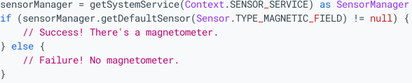
Identifying sensors and sensor capabilities
Get the object of sensor
Check whether specific sensor is available or not

Slide 9
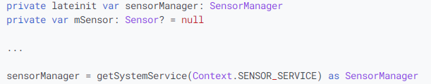
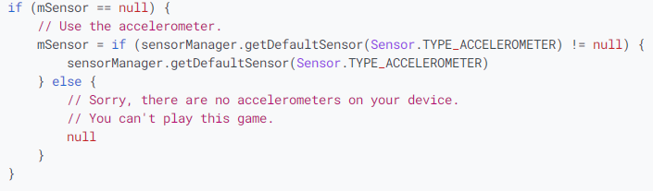
Identifying sensors and sensor capabilities
Create and work with sensor

Slide 10
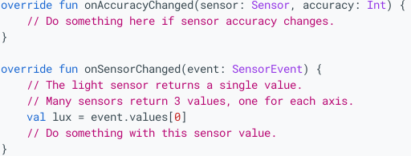
Monitoring Sensor Events
Register the listener
Implement the Listener interface
Listen the events in these methods

